Slide 1



Stress tests with
Jmeter & Blaze Meter

Slide 2
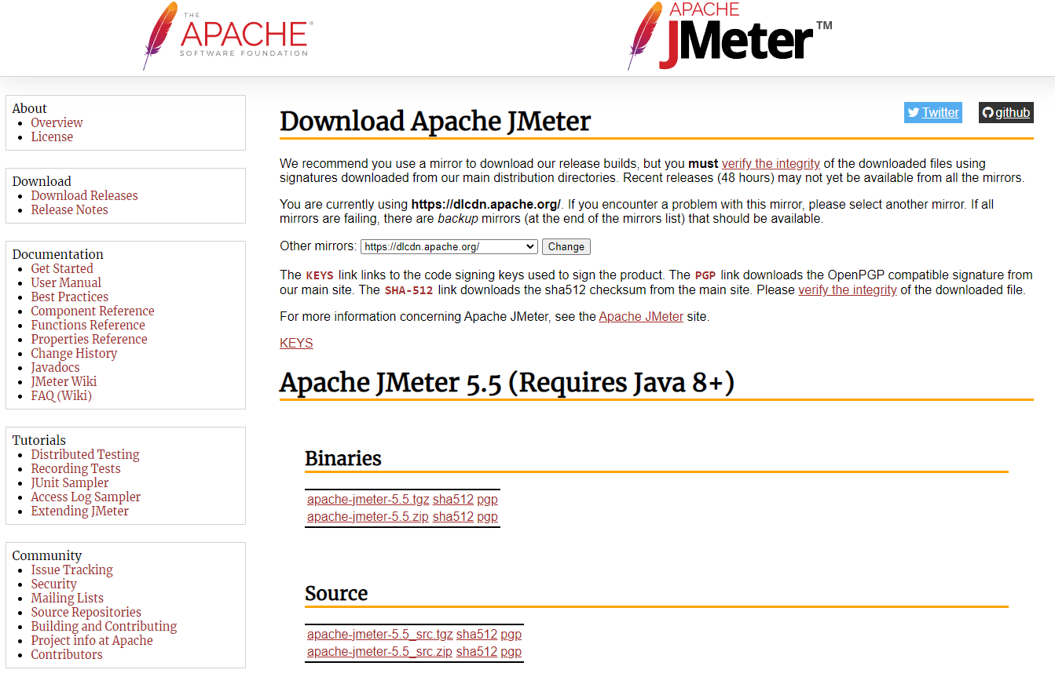
Installation
Go to: https://jmeter.apache.org/download_jmeter.cgi
Download Jmeter for Java 8

Slide 3
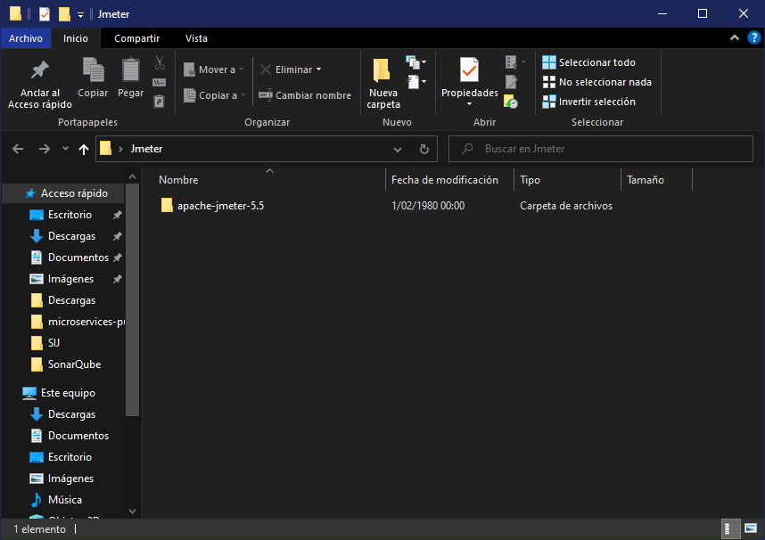
Installation
Extract the files of
the download in a folder

Slide 4
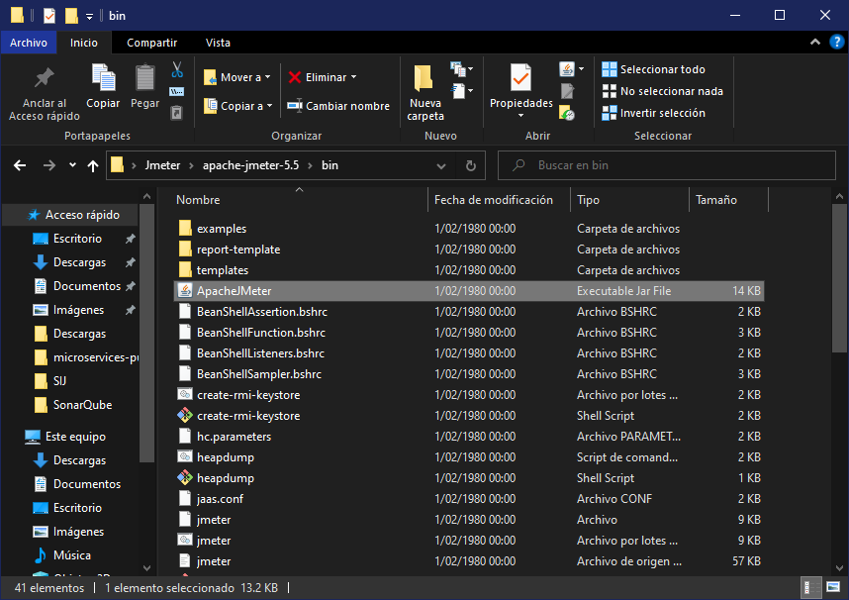
Installation
Inside the bin folder, run ApacheJMeter

Slide 5
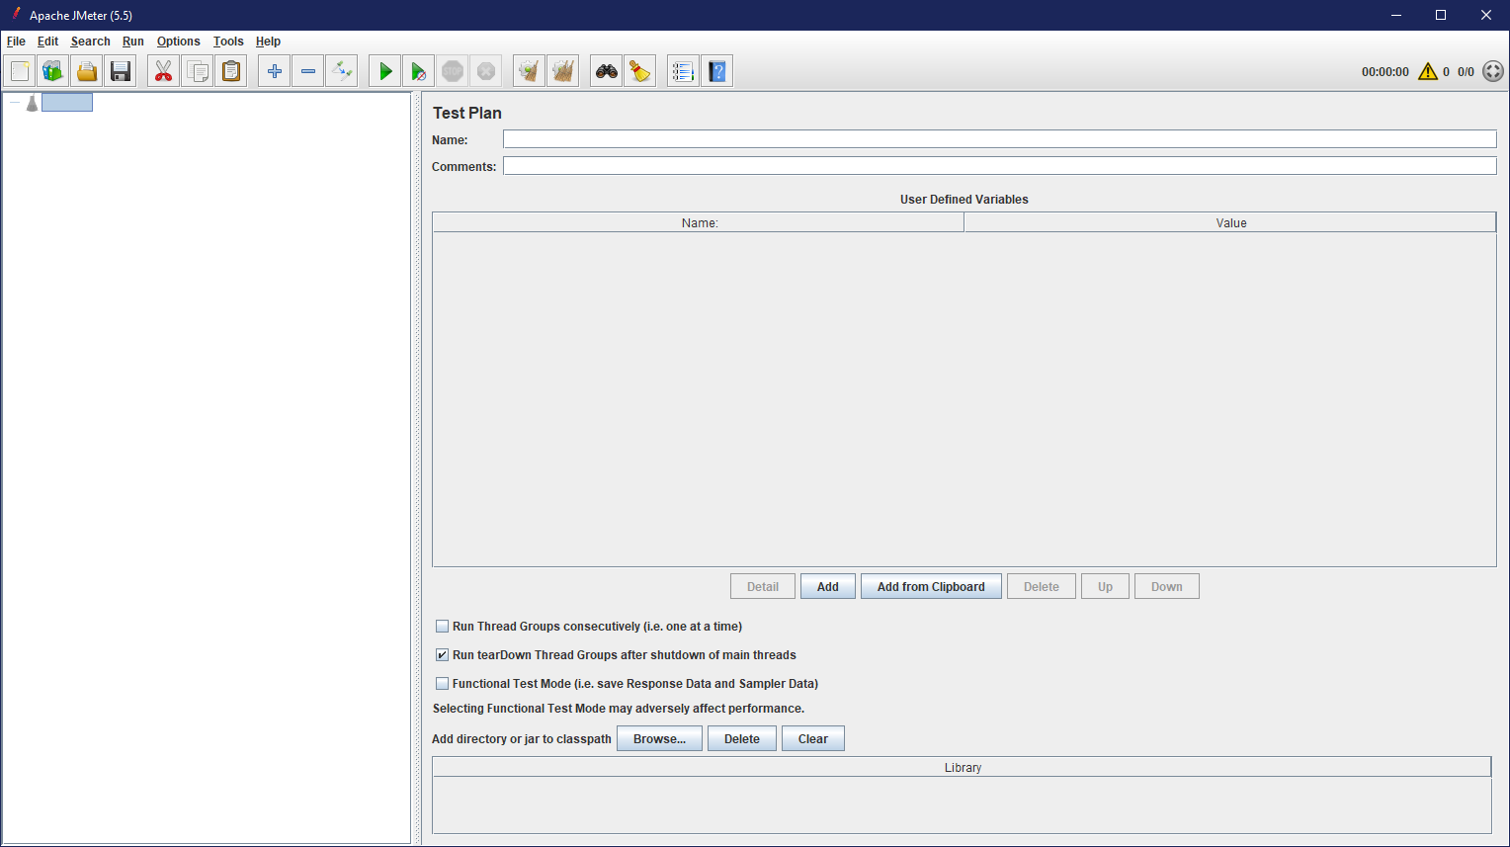
JMeter

Slide 6
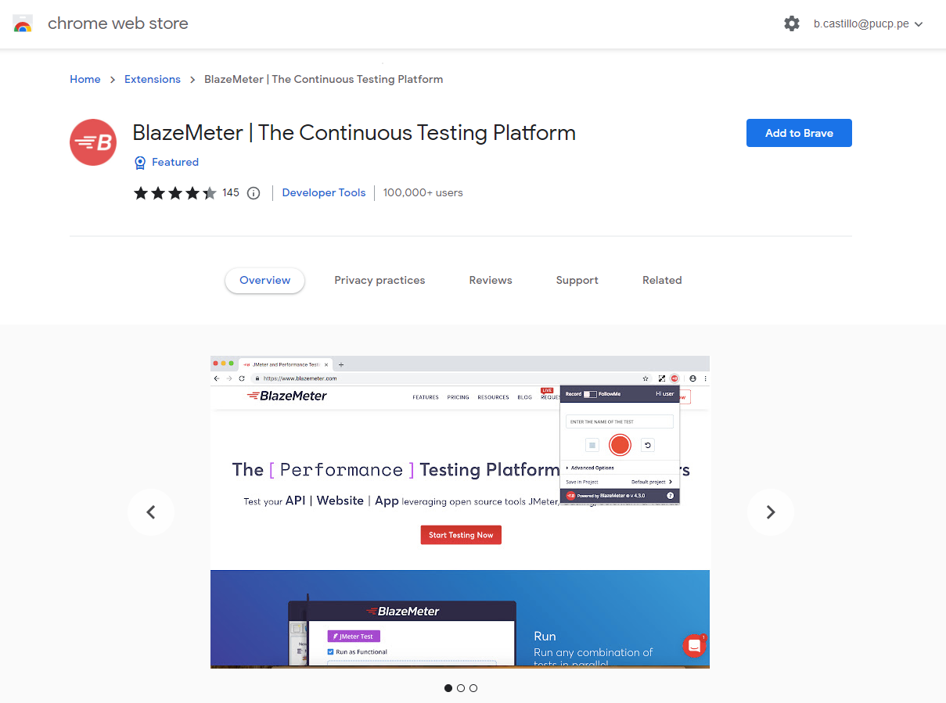
Blaze Meter
In the Chrome web store we have to add the BlazeMeter extension

Slide 7
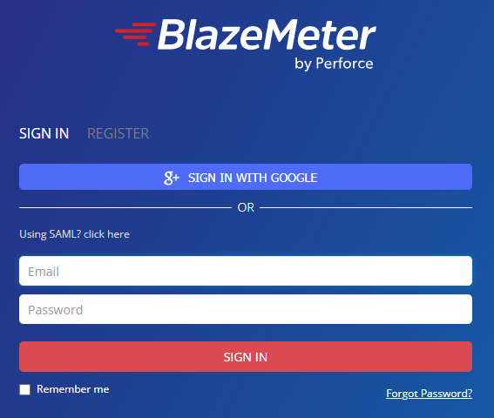
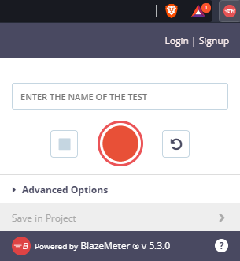
Blaze Meter
Click on the Extension and then click on login, being that previously we need to create an account.

Slide 8
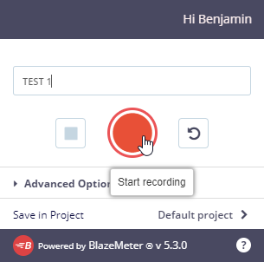
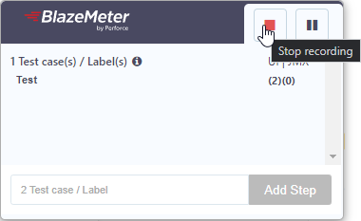
Exercise
To perform a test in Blaze Meter we need to enter the name of the test (TEST 1)
Then click on Start Recording (Red Button)
Then when the test case is finished clicking on the button Stop (red button).

Slide 9
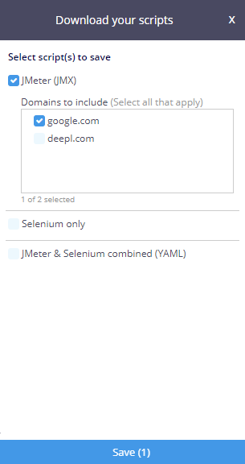
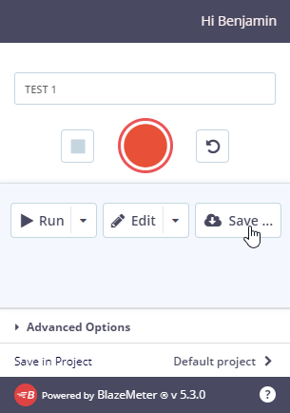
Exercise
After the recording has been processed we need to click on Save, and save the file.
Then we choose to download in JMeter and click on save and wait for it to download.

Slide 10
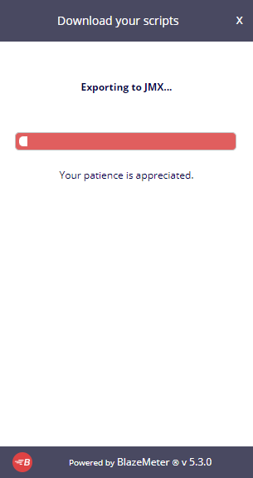
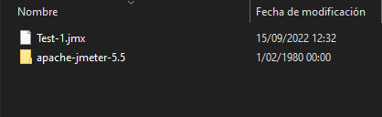
Exercise
After the recording has been processed we need to click on Save, and save the file.
Then we choose to download in JMeter and click on save and wait for it to download.

Slide 11
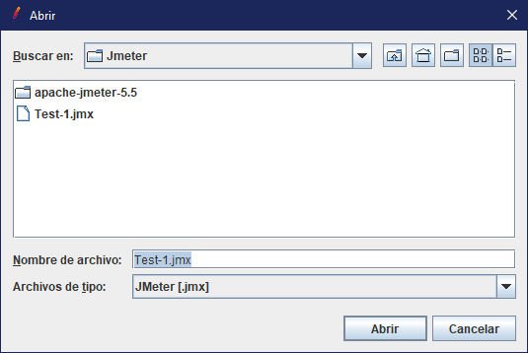
Exercise
In JMeter go to File/Open and select the file that we just downloaded from blazemeter

Slide 12
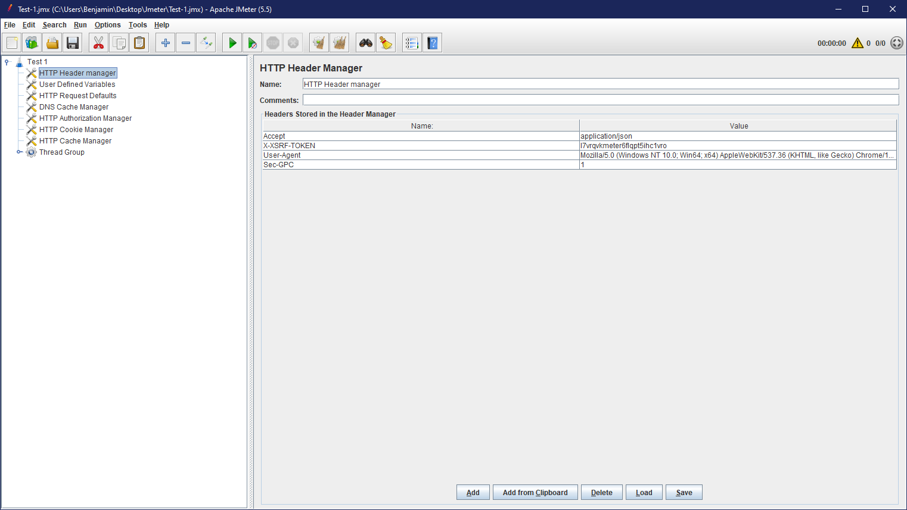
Exercise
Now that this is done, we can now visualize the test plan in JMeter.

Slide 13
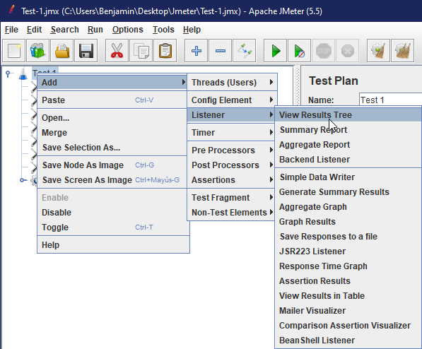
Exercise
Continuing with the exercise, what we will do is to add a View Results Tree, an Graph Results and view Results in table

Slide 14
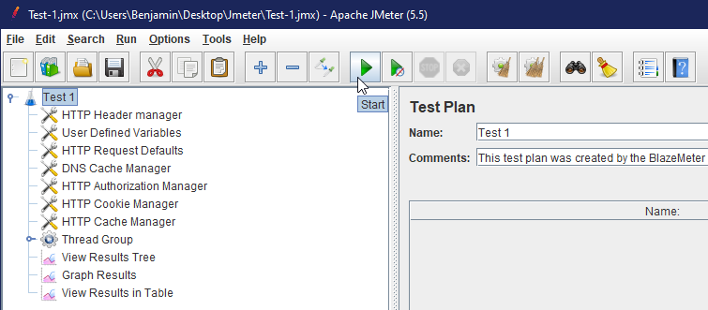
Exercise
Once the tests have been added, click on start to start the test.

Slide 15
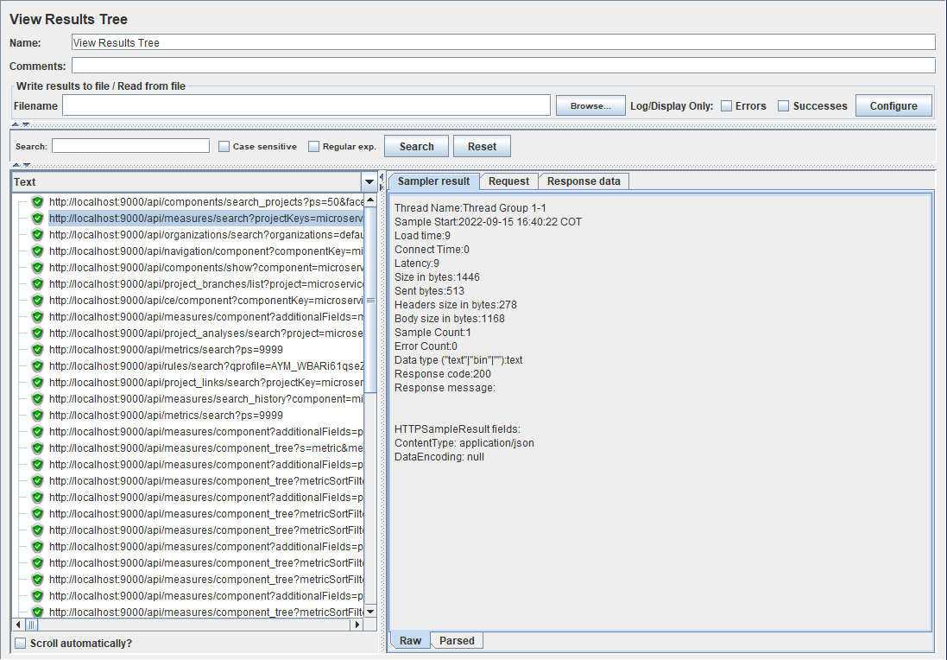
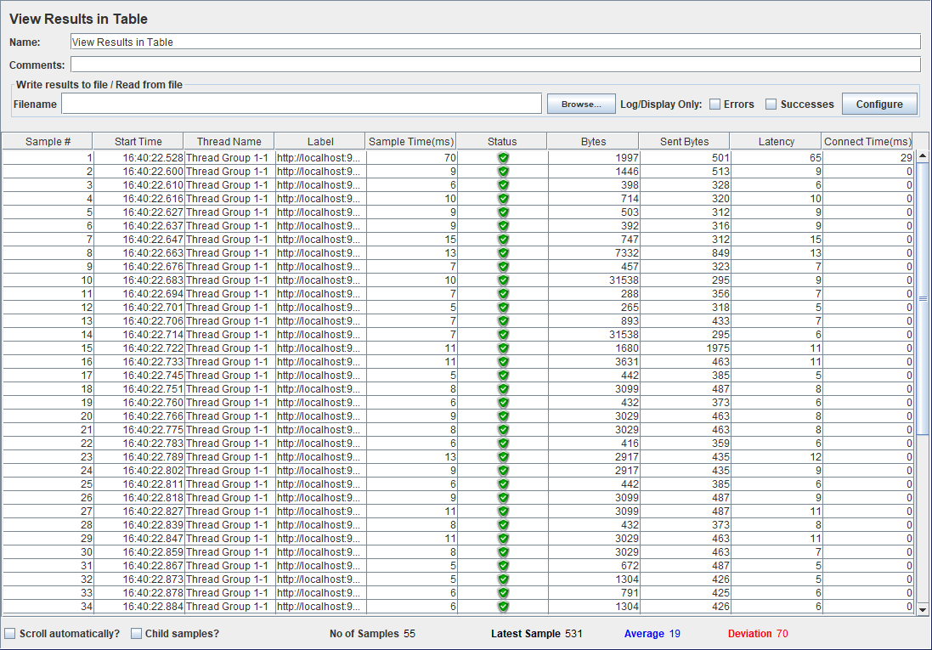
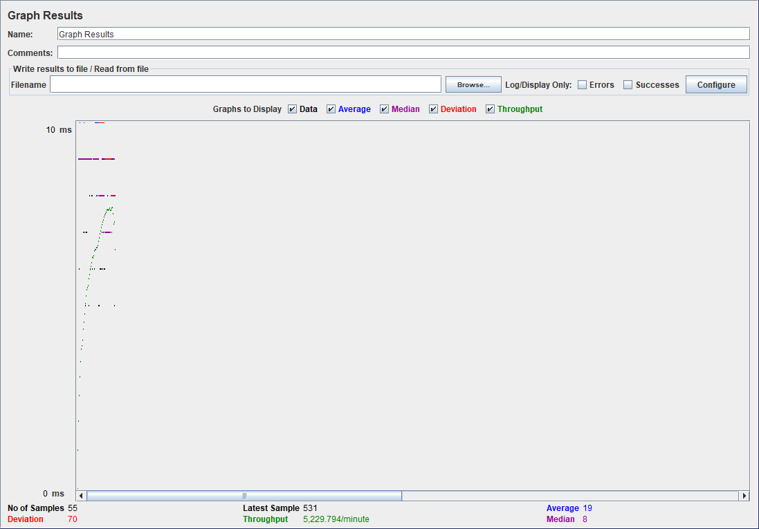
Analysis Results

Slide 16
Stress tests on APIS with
Jmeter

Slide 17
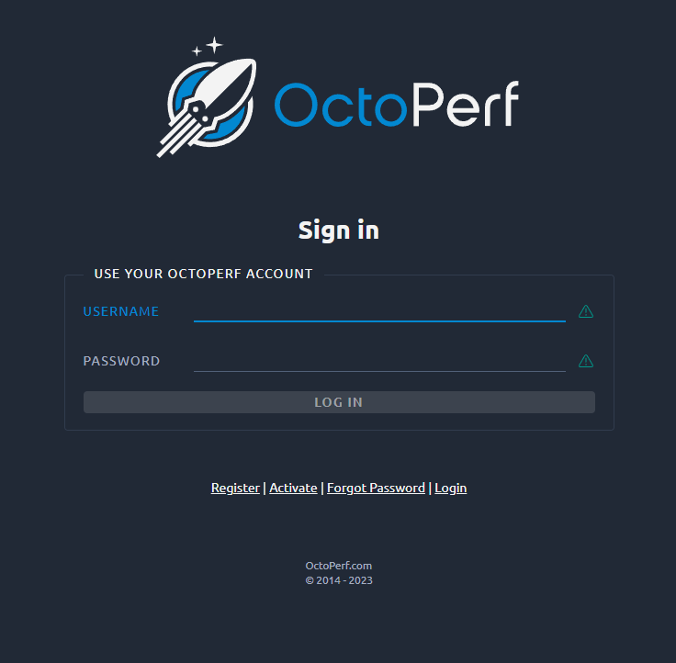
Exercise
For this test we will use a REST API LOGIN using the OctoPerf platform as an access point.

Slide 18
Exercise
In order to run this test we need the following parameters to call the api and allow us to log in
Http method: In this case we would make use of a Get and a Post request.
Http scheme: For the example we would make use of https since the Rest API we are using is secured by SSL
Hostname: api.octoperf.com
Path: /public/users/login (Place where the login will take place)
Other Requirements: It is necessary to have a previously created account to be able to point to the API with an User and a Password
Port Number : 443
https://doc.octoperf.com/design/edit-virtual-user/configuration/servers/

Slide 19
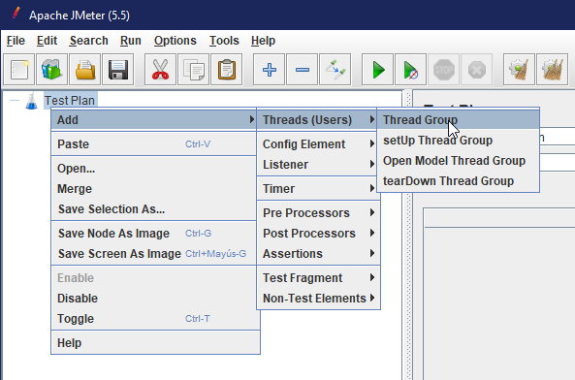
Exercise
First of all in our test plan we need to add a Thread Group

Slide 20
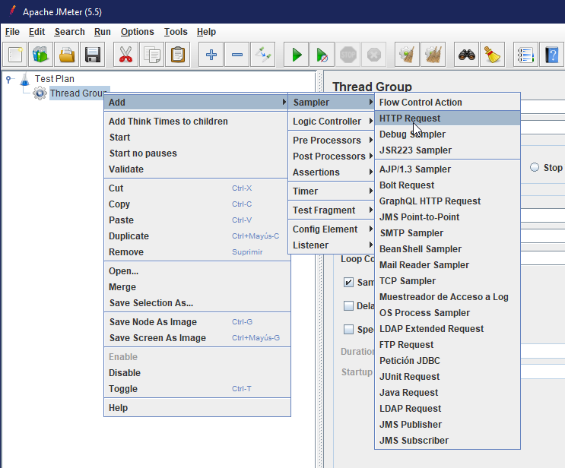
Exercise
Then in our Thread Group we need to add an HTTP Request

Slide 21
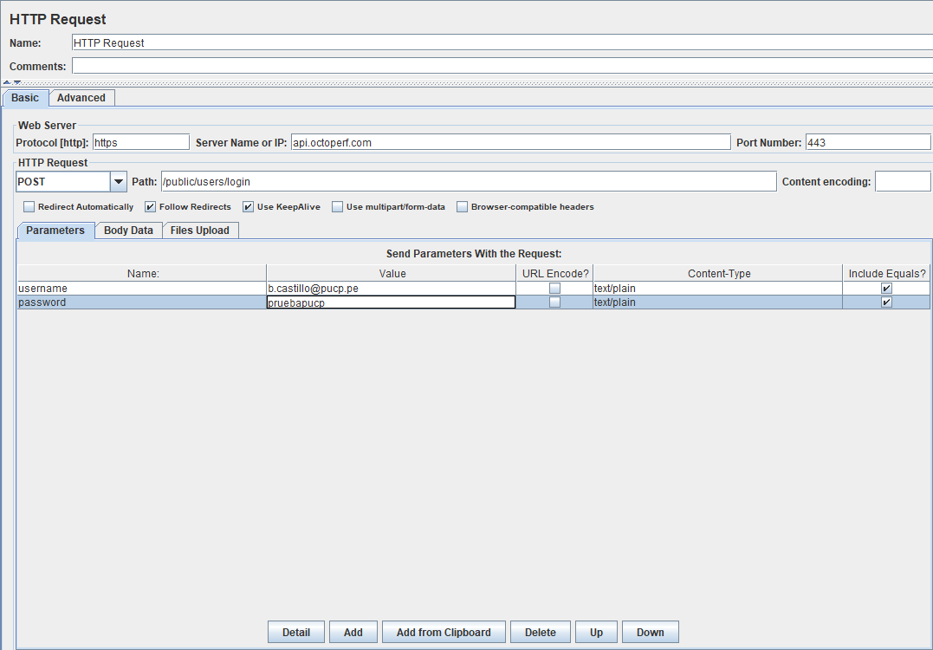
Exercise
Here in the HTTP Request we need to add the Protocol , the server name, the port number , the path and the parameters that in this case would be the username and the password

Slide 22
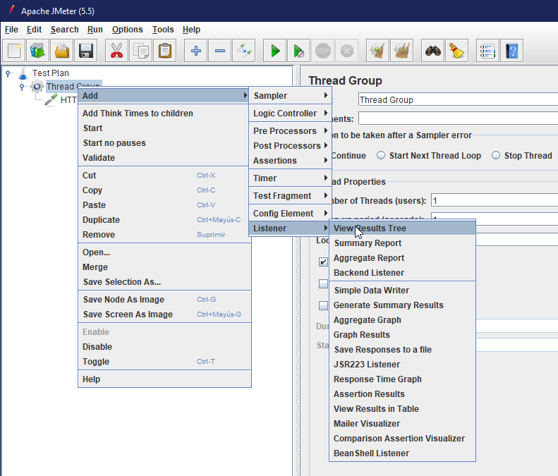
Exercise
In order to see the results we will make use of a test tree

Slide 23
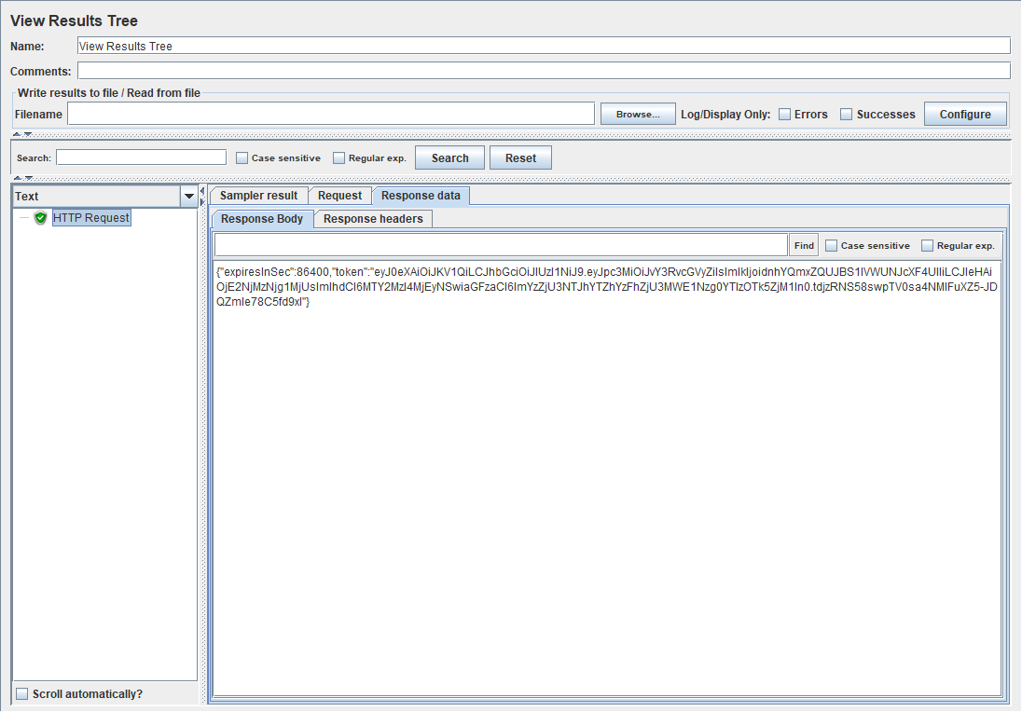
Exercise
Here we can see that the response of the request is a token for our user

Slide 24
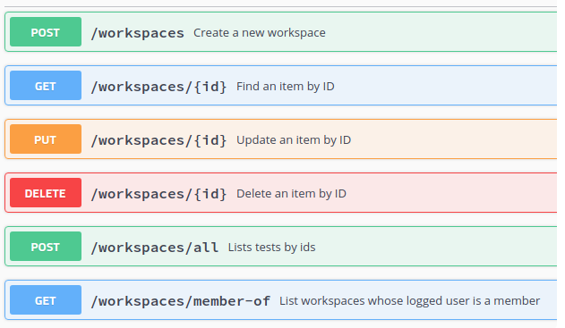
Using the token received
Since the response at the time of making the post is a token, we can say that its authentication is based on the use of a token, being a mechanism where each token identifies a user in a single session.
So we are going to use this token to call new methods
These methods that this api can handle can be seen in:
https://api.octoperf.com/swagger-ui/index.html#/

Slide 25
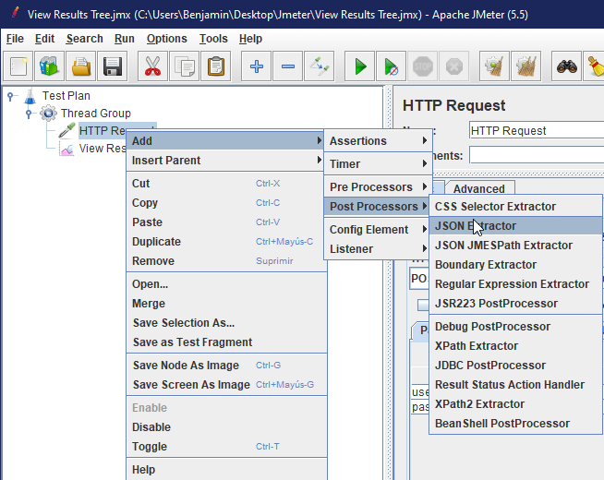
Extracting the Token
Using the Json Extractor in JMETER

Slide 26
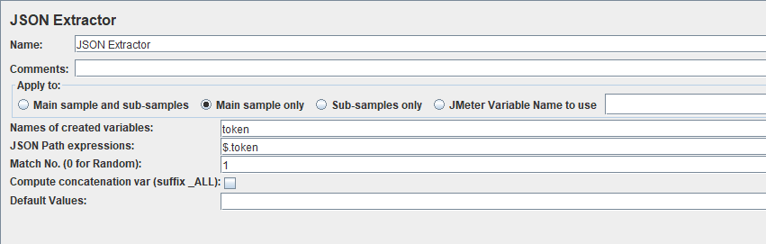
Extracting the Token
In order to extract the token we need to indicate the Json Path Expression and the Http Request match

Slide 27
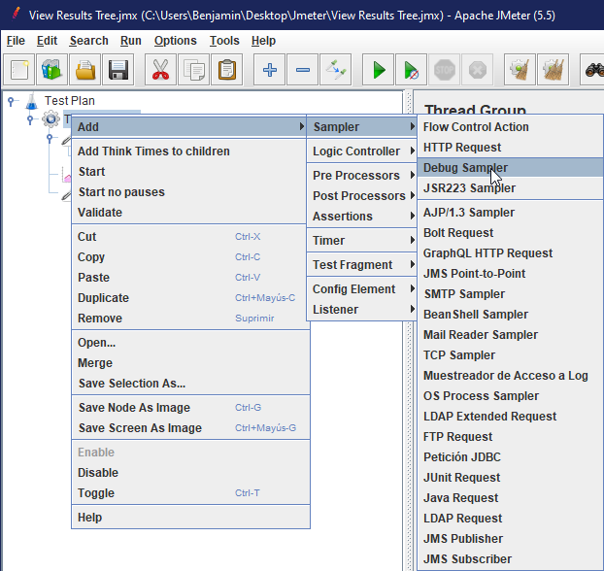
Extracting the Token
To visualize the Token we can use a debugger

Slide 28
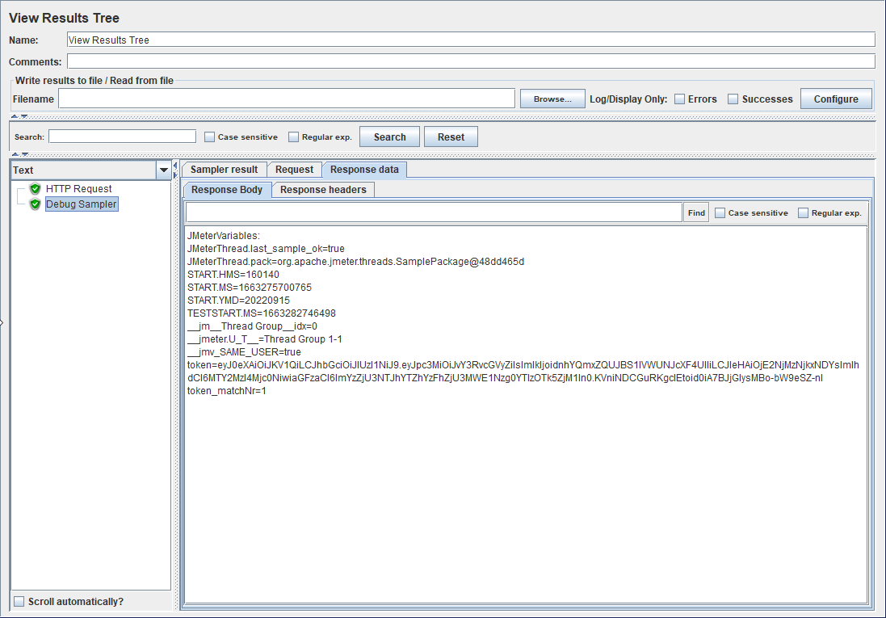
Extracting the Token
Here we can see that the token of our request is obtained by our debug sampler

Slide 29
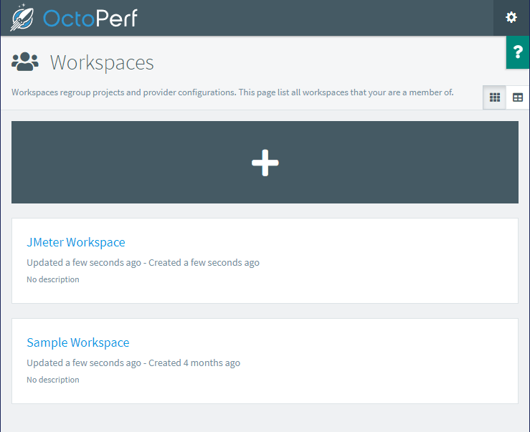
Working with JMETER
Now in order to continue working with the api we will get the workspaces using the Get method where we should be able to visualize these two:
Sample Workspace and Jmeter Workspace

Slide 30
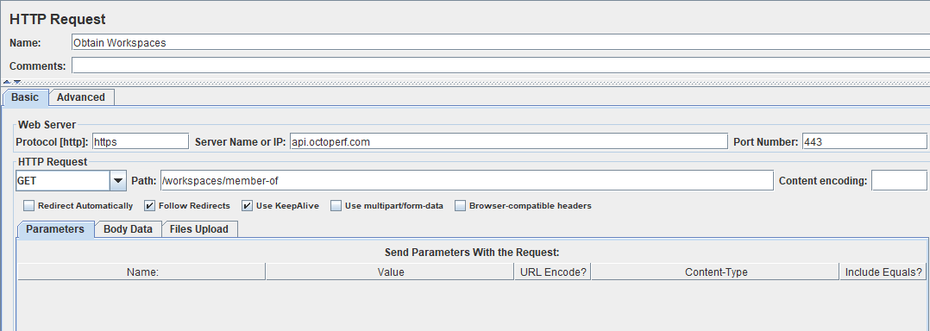
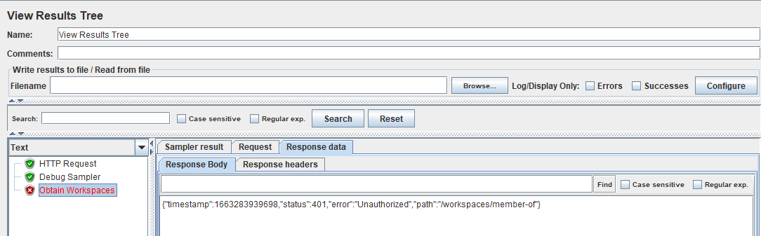
Get Request in JMeter
Using our HTTP GET Request without our Token

Slide 31
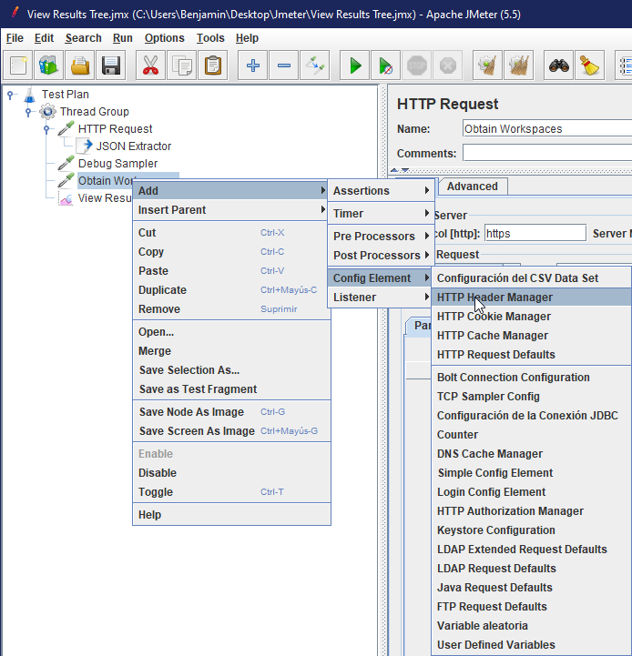
Get Request in JMeter
Calling our Token using an HTTP Header manager to use it in our HTTP Get Request to have authorization for obtain the workspaces

Slide 32
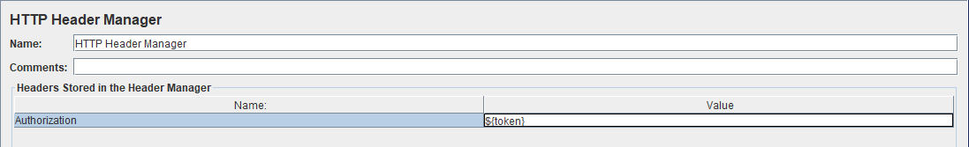
Get Request in JMeter
Adding to our HTTP Header Manager our previously obtained token in the Debug Sampler

Slide 33
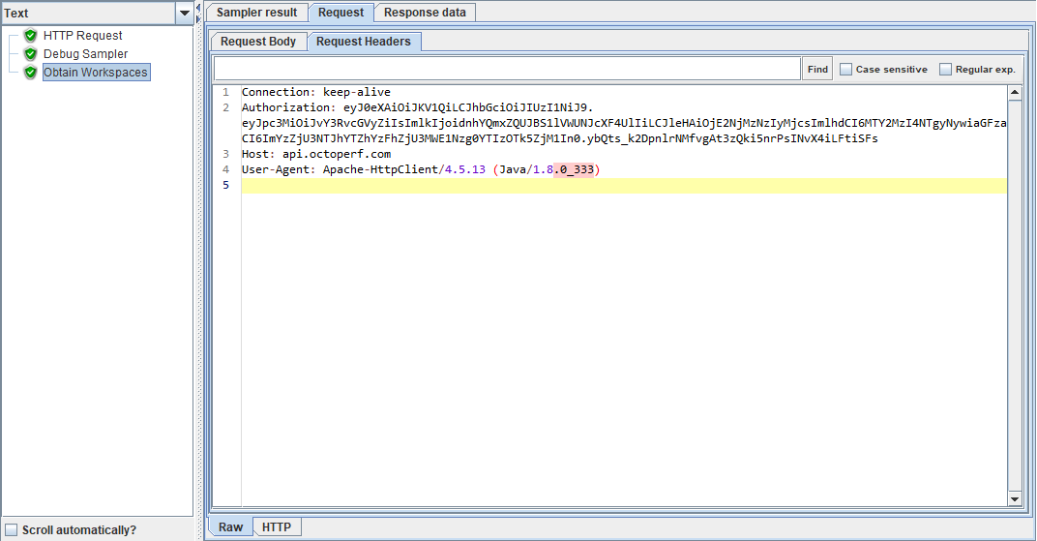
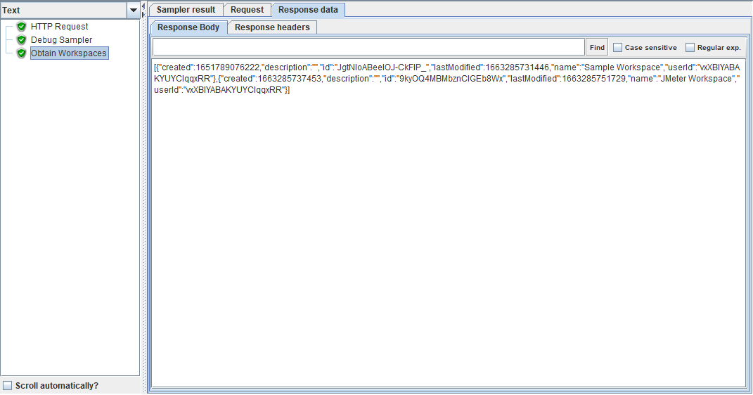
Get Request in JMeter
Obtaining the workspaces but now with the token in our request

Slide 34
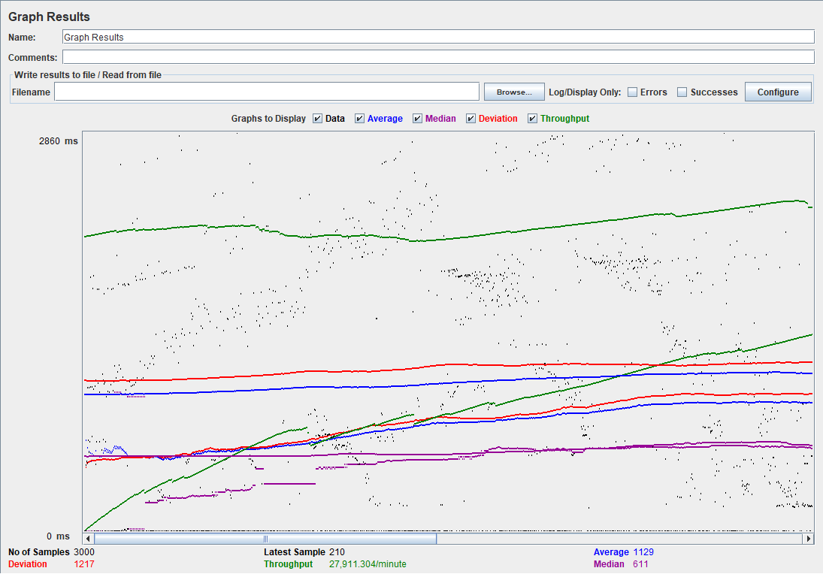
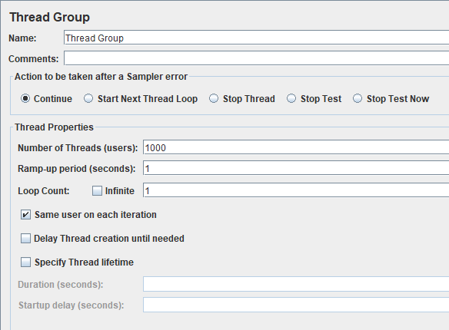
Stress Test
Viewing performance in the Results Graph with a 1000 threads

